Slide 2

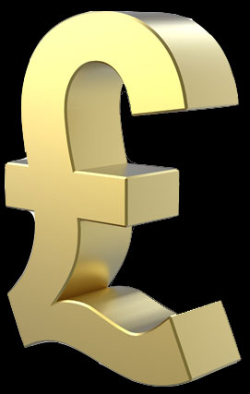
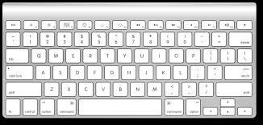

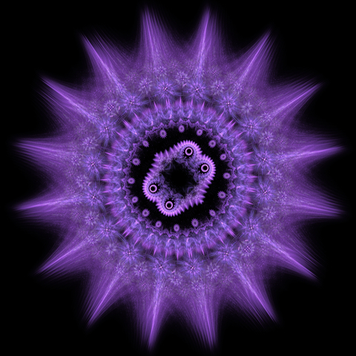
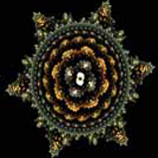



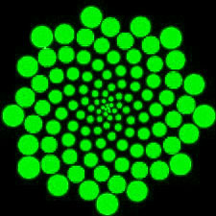
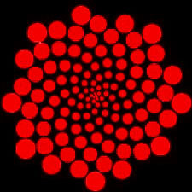

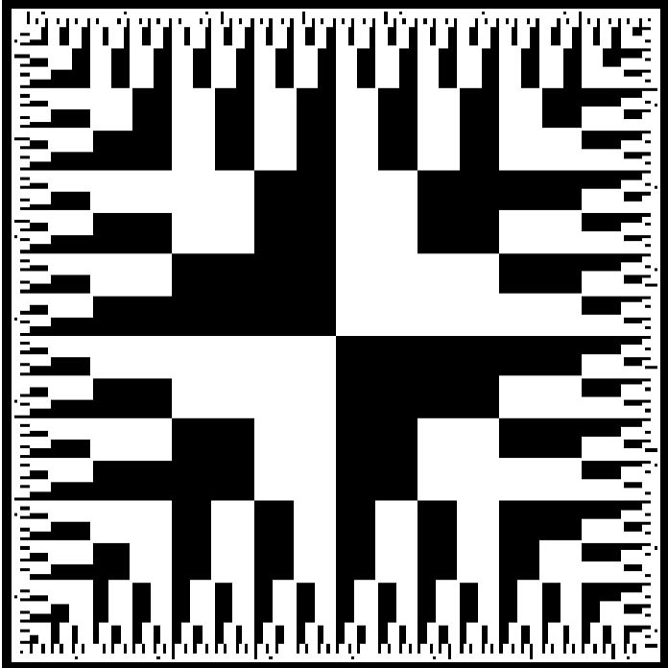

1 seconds
Wait 0.5 seconds
1 seconds
1 seconds

Slide 3
The Game…
Practice session:
1 seconds
Wait 0.5 seconds
1 seconds
1 seconds

Slide 4
The Game…
Practice session:
1 seconds
20 trials (training)
20 trials (training)
Wait 0.5 seconds
1 seconds
1 seconds

Slide 5
The Game…
Practice session:
1 seconds
20 trials (training)
20 trials (training)
Wait 0.5 seconds
20 trials (Money collection)
1 seconds
Game session:
1 seconds

Slide 6
The Game…
Practice session:
1 seconds
20 trials (training)
?
?
?
?
20 trials (training)
Wait 0.5 seconds
20 trials (Money collection)
?
?
?
?
1 seconds
Game session:
?
?
1 seconds

Slide 7
The Game…
Practice session:
1 seconds
20 trials (training)
?
?
?
?
20 trials (training)
Wait 0.5 seconds
20 trials (Money collection)
?
?
?
?
1 seconds
Game session:
20 trials (training)
20 trials (training)
?
?
1 seconds

Slide 8
The Game…
Practice session:
1 seconds
20 trials (training)
?
?
?
?
20 trials (training)
Wait 0.5 seconds
20 trials (Money collection)
?
?
?
?
1 seconds
Game session:
20 trials (training)
20 trials (training)
?
?
1 seconds
500 trials (Money collection)

Slide 9

